Slide 1
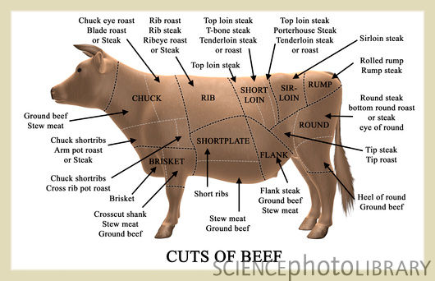

Slide 2
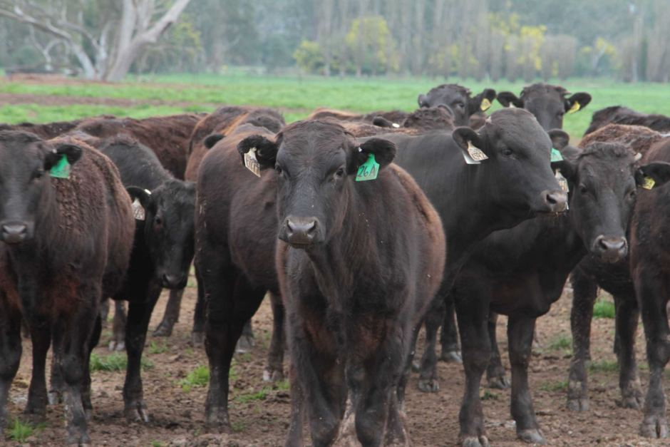

Slide 3
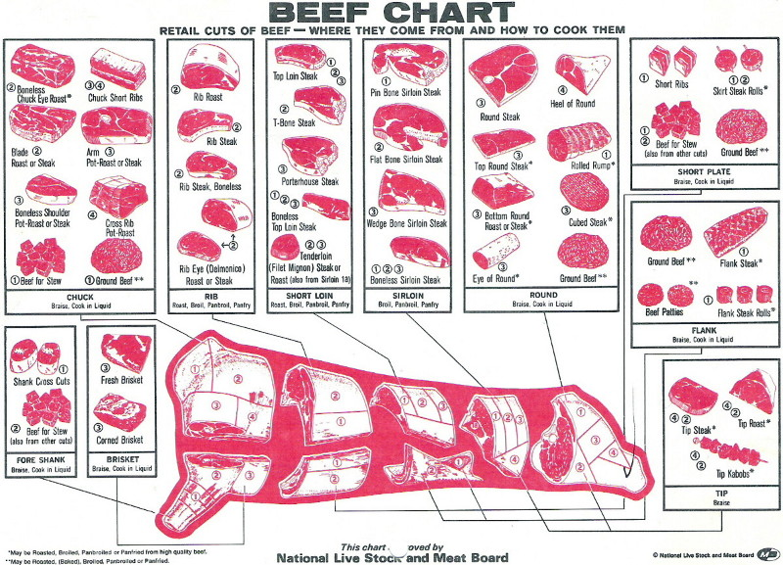

Slide 4
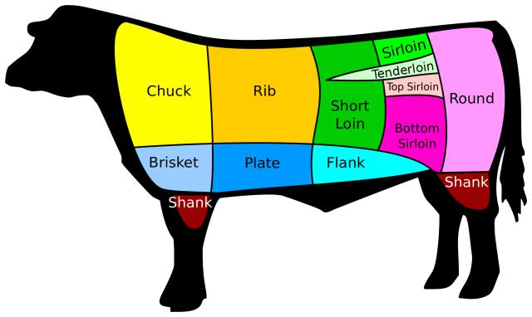
Beef Chart

Slide 5
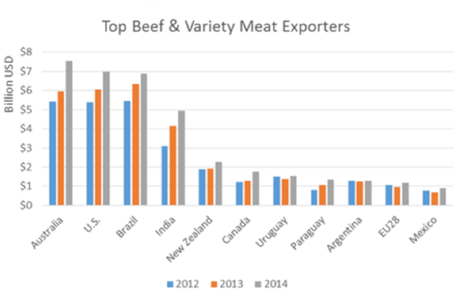

Slide 6
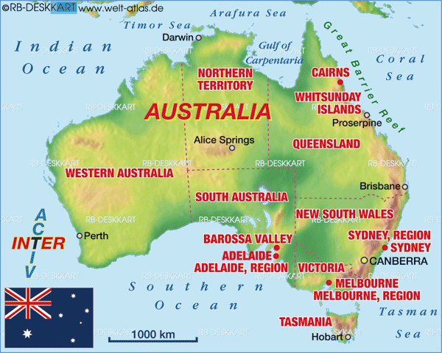

Slide 7
Cattle
Beef “cattle’’ are slaughtered generally at 18 months old.
There natural life span of cattle is 15-20 years old.
Halal meat is term from the way the animal has been slaughtered.

Slide 8
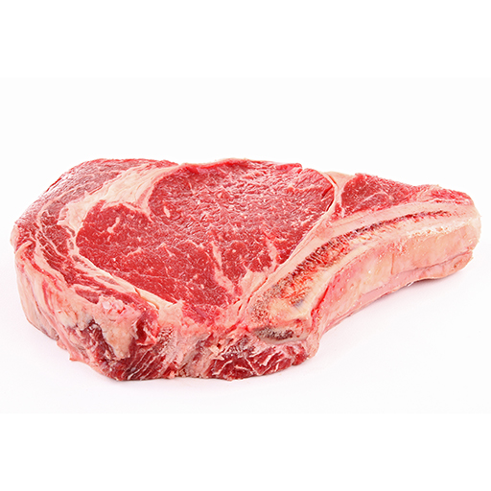
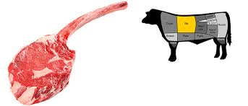
Rib eye bone in Tomahawk
The rib eye bone in and tomahawk are from the rib section of the cow which contains a small amount of fat which is good for the flavor of the meat. This part of the animal is not used too much so the meat is tender when cooked and very juicy with generous marbling throughout one the most tender pieces of meat.
The best cooking method for this cut is grilling.
The reason the rib eye bone in is sometimes called tomahawk is that tomahawk has a larger bone.

Slide 9
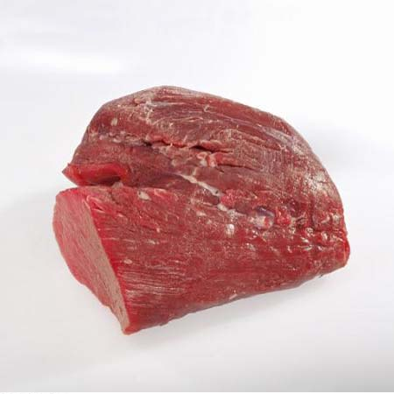
Tenderlion Chateaubriand
Beef Tenderloin Chateaubriand
The beef tenderloin is found on the short loin section of the cow which runs alongside the spine and is regarded as a prime piece of meat very succulent flavor.
It is known buy quite a few names such as Eye fillet, Fillet mignon which is the French meaning, Tournedos which is the centre part of the tenderloin, Medallions which is when the beef has been broken down into portions and Chateaubriand which is a thick cut of meat connected to the tenderloin good for roasting and sharing. The beef tenderloin and Chateaubriand is regarded to be one of the most tender cuts of meat on the cow so is best for grilling of sous vide.

Slide 10
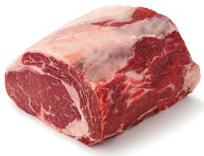
Cube Roll Boneless Rib Eye The cube roll or bone less Rib eye are from the Rib section again same cut as the Rib eye bone in but the bone has been removed. This can also be known as Scotch fillet which is mainly a term used in Australia New Zealand. In America this cut is also known as a beauty steak. Again this is a prime cut of the cow and is best used for grilling as it is very tender and has a good marbling of fat.

Slide 11
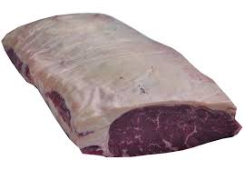
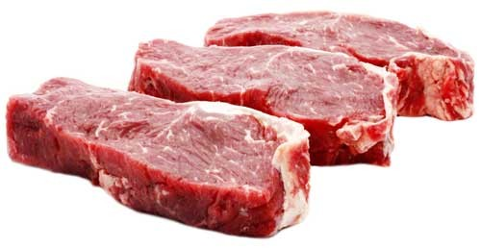
Striploin New York Strip
The Striploin is from the short loin section of the cow again this muscle does little work but is not quite as tender as the Tenderloin or Rib eye. This can also be known as a New York Strip which is famous from a restaurant called Delmonico’s that opened in 1827 in New York and was offered as a signature cut which became known as a Delmonico steak because of its association with the city.
This cut is best for grilling.
Its lean, tender and full-flavored.

Slide 12
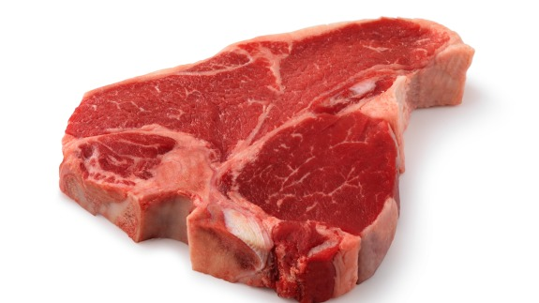
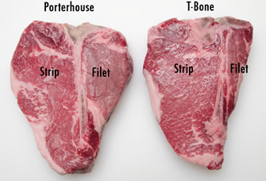
T-Bone Porterhouse This cut is from the rear end of the Short lion and is made up from the Striploin and Tenderloin. The difference between a Porterhouse and a T-bone is that a Porterhouse is generally much larger as the fillet is much bigger and is most commonly served for two people. This cut is very common in Steakhouses and is best for grilling.

Slide 13
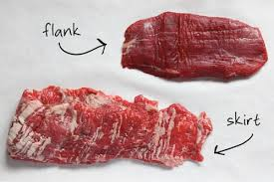
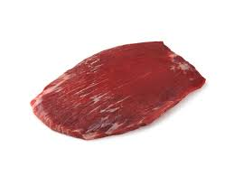
Flank Steak London Broil
The Flank steak is a cut from the abdominal muscles of the cow. In Colombia this cut is known as Sobrebarriga which means over the belly. It is a well exercised part of the cow so can be tough. Other names for this cut is London Broil due to a famous dish from North America which involves using flank steak and marinating in vinegar and white wine. Due to this being a tough part of the cow is best cooking method is braising for increased tenderness.

Slide 14
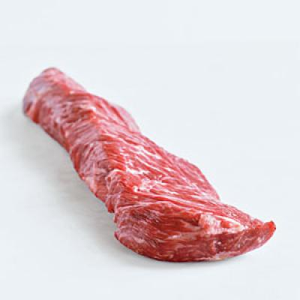
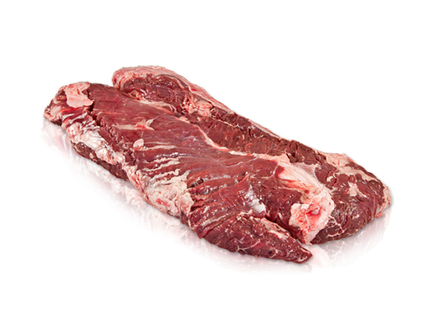
Hanger Steak Butchers Steak
This cut is from the plate of the cow and is also known as butchers steak because butchers would rather keep it for themselves than sale it. The cut is a v-shaped pair of muscles. This is classed as a secondary cut but I actually quite tender and has good flavor and best method of cooking would be grilling.

Slide 15
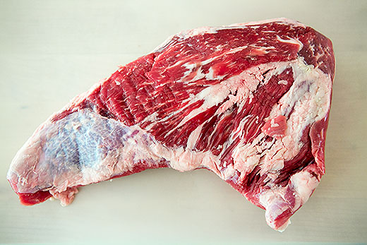
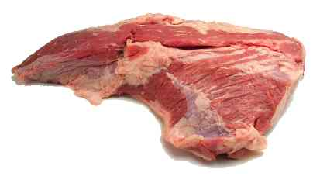
Tri-Tip Triangle Steak
This cut is from the flank of the animal and is a triangle shape hence the reason it is also called triangle steak. Also can be know as Santa Maria Steak due to its connections of BBQ cooking. It can be quite chewy as it contains quite a lot of sinew so best method of cooking would be sous vide over a long period of time or slow roasted.

Slide 16
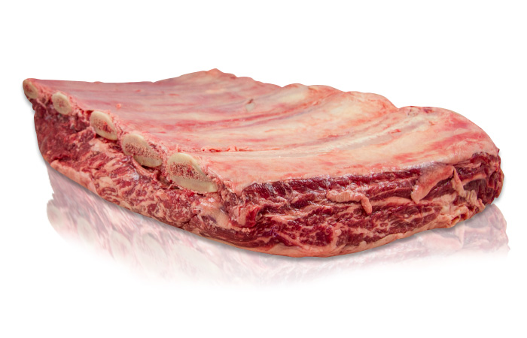
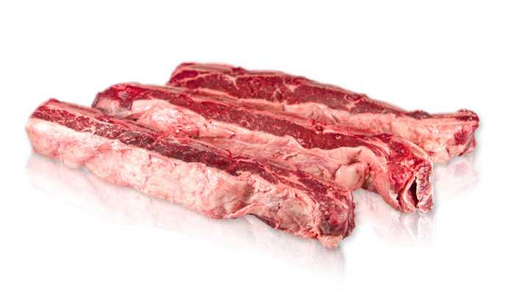
Short rib
The short rib is a cut from the rib section of the cow also know as the plate section. This can be very tough but so is best for braising or sous vide it is regarded to have a very strong flavor.

Slide 17
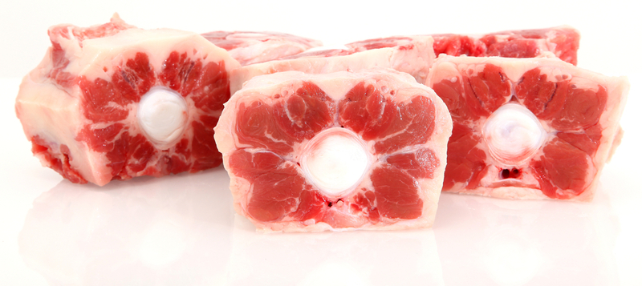
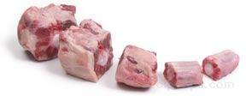
Oxtail
Oxtail is the culinary name for the tail of a cattle. Oxtail is a bony, gelatin meat which is best cooked braised as it get used a lot.

Slide 18
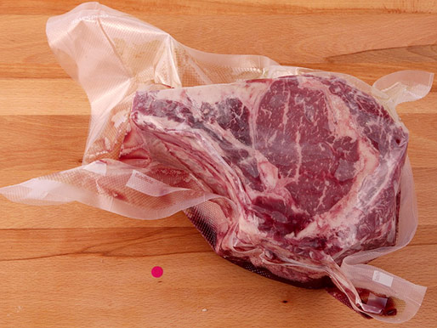
Wet aging
Wet aging is a very simple process of putting beef in a vac pac bag and then sealing it. It is popular with producers as it takes less time, typically only a few days and there is no moisture loss. You can wet age for up to 30 days. This process helps tenderize the meat and keeping it moist as it is in a sealed vac bag.

Slide 19
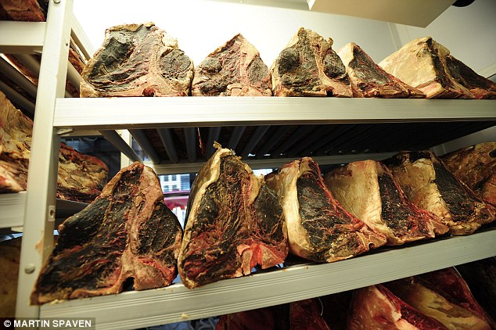
Dry aging
Dry aging is a process to improve tenderness and enhance flavor. When in dry aging process it is stored between 1c and 5c degrees. It is also important to have airflow in the cool room as this helps speed up the drying process. You have to hang the beef for a minimum of 15 days for it to be called dry aged, you also dry age for up to 150 days and more.

Slide 20
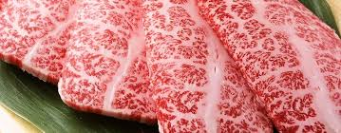
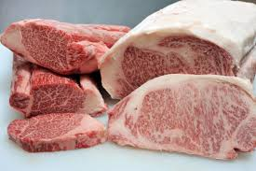
Wagyu beef
Wagyu beef is a type of beef that has been reared with techniques that include massaging, adding beer or sake to there feeding regimen and in some cases playing music to relaxing the cow so that animal is not stressed which means there muscle is always going to feel relaxed and the meat is more tender.

Slide 21
Grain fed-beef
Cattle called Grain-fed can also be known as corn-fed or corn-finished are typically fattened on maize, soy and other types of feed for several months before slaughter. As a high-starch, high-energy food, corn decreases the time to fatten the cattle and increases carcass yield. Some corn-fed cattle are fattened in concentrated animal feeding operations known as feed lots.

Slide 22
Grass fed
In grass-fed or pasture-fed cattle, grass and other forage compose most or the majority of the grass-fed diet. The debate is whether cattle should be raised on diets primarily composed of pasture (grass) or a concentrated diet of grain, soy, and other supplements. The issue is often complicated by the political interests and confusion between labels such as free range, organic, or natural. Cattle raised on a primarily forage diet are termed grass-fed or pasture-raised.

Slide 23
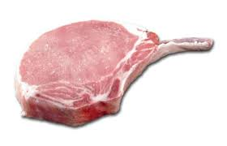
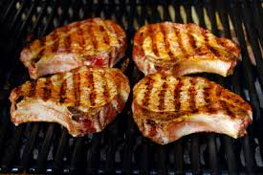
Pork Chop
Pork chop is a cut from the spine of the pig usually containing a rib bone served as a individual portion. The Pork chop has quite a bit of fat around the meat to keep it moist. When the bone and fat is removed it is know as the pork lion. The method cooking is either roasting or grilling.

Slide 24
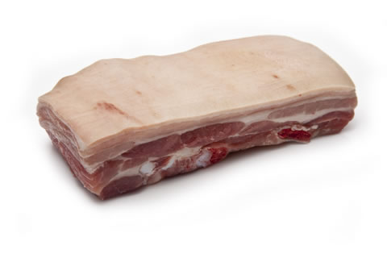
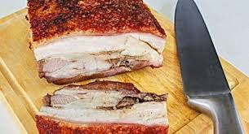
Pork Belly
Pork Belly is a boneless cut of fatty meat from the belly of a pig. Pork can also be used for pancetta which is a type of Italian cured bacon. There are lots of different methods of cookery used for pork belly such as sous vide, braising, confit and roasting. It is very important to get the skin crispy for crackling. The best method for making cracking is either roasting the pork belly in the oven or removing the skin and bring it up to the boil in water and then drying the skin and then deep frying.

Slide 25
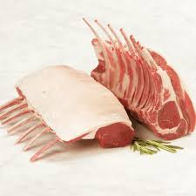
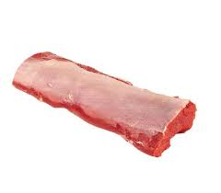
Lamb Rack Lamb back strap
Lamb rack is a cut that runs along the spine and contains 8 ribs on each side. It is a prime piece of meat on the lamb is served with the bones on cleaned of frenched which is a term for removing the fat from the bones. This cut is best cooked grilled, roasted or sous vide. Lamb back strap is a cut from the saddle of lamb and is also know as lamb loin best cooking method is sous vide or roasting.

Slide 26
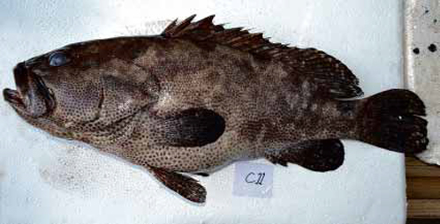
Lapu Lapu
Lapu Lapu is what the Philippines call grouper which is a classification of fish. Grouper can grow in excess of 40kg. There flesh is white and very soft and tender when cooked best methods of cooking are sous vide, grilling or pan roasted.

Slide 27
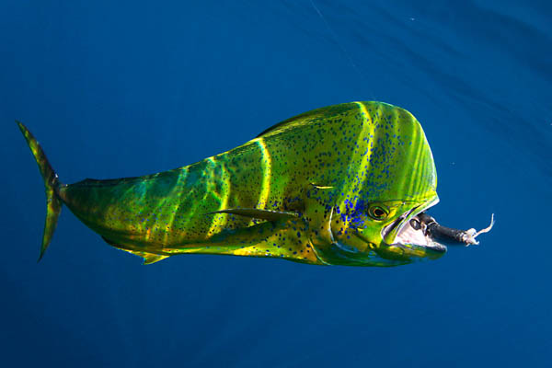
Mahi Mahi
The name Mahi Mahi means very strong in Hawaiian. They can live up to 5 years old they can range between 7 to 15 kg in weight. There flesh is sort and oily the skin is quite tough so should be removed. Best cooking method is grilling or sous vide.

Slide 28
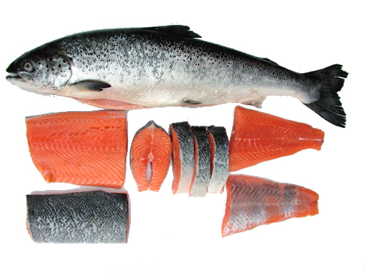
Salmon
Salmon comes from the Latin term Salmon which means leap. Salmon is more native to North Atlantic and Pacific Ocean. Salmon are typically born in freshwater and migrate to the ocean. Salmon is classed as a oily fish. There are lots of different cooking methods that can used when cooking salmon which include sous vide, poaching, roasted, grilling, steaming and curing.

Slide 29
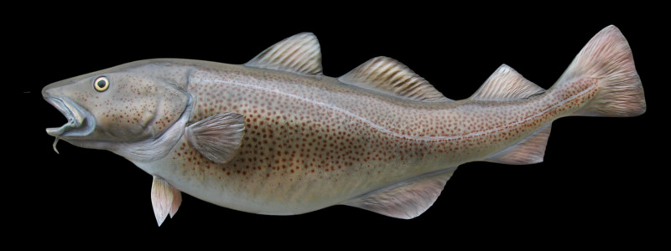
Cod
Cod is a very popular fish to eat they live in colder waters and deep sea. They are native to North Atlantic and Pacific Ocean. The flesh is white and dense can be quite flaky when cooked. Cooking methods include deep frying, grilling, steaming, poaching and pan roasting.

Slide 30
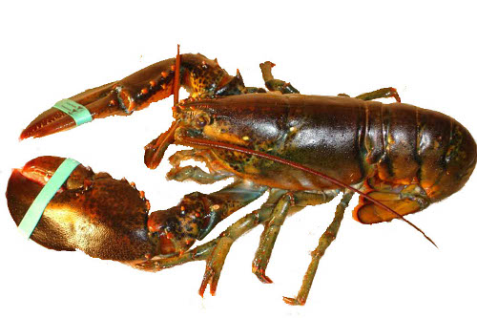
Lobster
Lobsters are known as crustaceans and in the shellfish category. Methods of cookery include steaming, boiling, grilling and sous vide. The shells of the lobster can also be kept to make lobster bisque which is a famous soup that originated in France.

